Slide 1


Virtualization
technologies
Part 4
DevOps Spring 2017

Slide 2
run&Commit
root@devops-21:/# docker run -it centos /bin/bash
[root@9191bb29ce6c /]# echo "hello 1" > ~/test1.txt
[root@9191bb29ce6c /]# <CTRL/D>

Slide 3
run&Commit
root@devops-21:/# docker run -it centos /bin/bash
[root@9191bb29ce6c /]# echo "hello 1" > ~/test1.txt
[root@9191bb29ce6c /]# <CTRL/D>
root@devops-21:/# docker run -it centos /bin/bash
[root@e4b8d9eab8c4 /]# cat ~/test1.txt

Slide 4
Ctrl-P&Ctrl-Q ; run
root@devops-21:/# docker run -it centos /bin/bash
[root@9191bb29ce6c /]# echo "hello 1" > ~/test1.txt
[root@9191bb29ce6c /]# <CTRL/D>
root@devops-21:/# docker run -it centos /bin/bash
[root@e4b8d9eab8c4 /]# cat ~/test1.txt
cat: /root/test1.txt: No such file or directory
[root@e4b8d9eab8c4 /]# <Ctrl/P><Ctrl/Q>

Slide 5
docker ps; docker ps –a; docker attach;
root@devops-21:/# docker ps
CONTAINER ID IMAGE COMMAND CREATED STATUS NAMES
e4b8d9eab8c4 centos "/bin/bash" 7 minutes ago Up 7 minutes infallible_mcnulty
root@devops-21:/# docker ps -a
CONTAINER ID IMAGE COMMAND CREATED STATUS NAMES
e4b8d9eab8c4 centos "/bin/bash" 7 minutes ago Up 7 minutes infallible_mcnulty
9191bb29ce6c centos "/bin/bash" 9 minutes ago Exited (0) 8 minutes ago tiny_euler
root@devops-21:/# docker attach tiny_euler
You cannot attach to a stopped container, start it first
root@devops-21:/# docker attach infallible_mcnulty
[root@e4b8d9eab8c4 /]# exit
root@devops-21:/# docker rm $(docker ps -aq)
e4b8d9eab8c4
9191bb29ce6c

Slide 6
docker logs
root@devops-21:/# docker attach 530113c4eb9f
[root@530113c4eb9f /]# while true; do echo 'hello!'; sleep 1; done;
hello!
hello!
<Ctrl/P><Ctrl/Q>
root@devops-21:/# docker logs -t 530113c4eb9f | tail -1
2017-03-27T19:25:38.798585118Z hello!
root@devops-21:/# docker logs -t 530113c4eb9f | tail -1
2017-03-27T19:25:41.803914092Z hello!
root@devops-21:/#

Slide 7
docker restart
root@devops-21:/# docker ps
CONTAINER ID IMAGE COMMAND CREATED STATUS PORTS NAMES
530113c4eb9f centos "/bin/bash" 10 minutes ago Up 10 minutes zen_allen
root@devops-21:/# docker restart zen_allen
zen_allen
root@devops-21:/# docker logs -t 530113c4eb9f | tail -1
2017-03-27T19:26:35.900321519Z hello!
root@devops-21:/# docker logs -t 530113c4eb9f | tail -1
2017-03-27T19:26:35.900321519Z hello!
root@devops-21:/# docker attach 530113c4eb9f
[root@530113c4eb9f /]#

Slide 8
docker commit
[root@530113c4eb9f /]# echo "Hello" > ~/hello.txt
[root@530113c4eb9f /]# root@devops-21:/#
root@devops-21:/#
root@devops-21:/# docker commit 530113c4eb9f test:1
sha256:b5cf2902bff73682a96fe1cada34efdad4beef5df1728ce369eda71320eeb1d9
root@devops-21:/# docker images
REPOSITORY TAG IMAGE ID CREATED SIZE
test 1 b5cf2902bff7 7 seconds ago 192.5 MB
centos latest 98d35105a391 11 days ago 192.5 MB
midnightconman/ec2cli latest cc3bdf4db266 12 months ago 169.3 MB
root@devops-21:/#

Slide 9
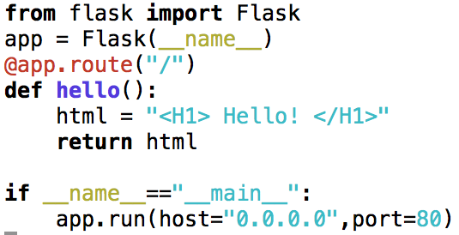
app.py
Notes:
app = Flask(__name__)
@app.route("/")
def hello():
html = "<H1> Hello! </H1>"
return html
if __name__=="__main__":
app.run(host="0.0.0.0",port=80)

Slide 10
Dockerfile
FROM python:2.7
WORKDIR /app
RUN pip install flask
ADD app.py /app/app.py
EXPOSE 80
CMD ["python","app.py"]

Slide 11
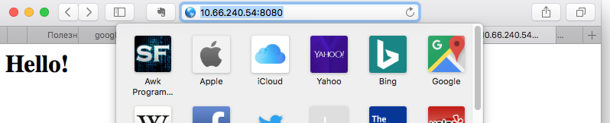
Run
docker build -t py .
docker run -d --name pytest -p 8080:80 py

Slide 12
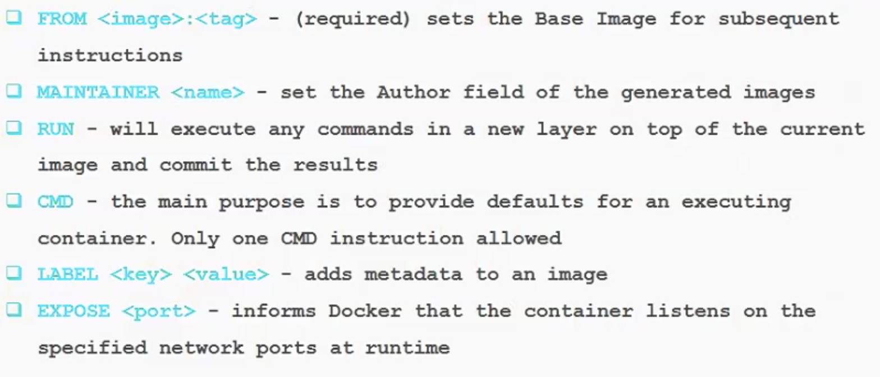
Dockerfile

Slide 13
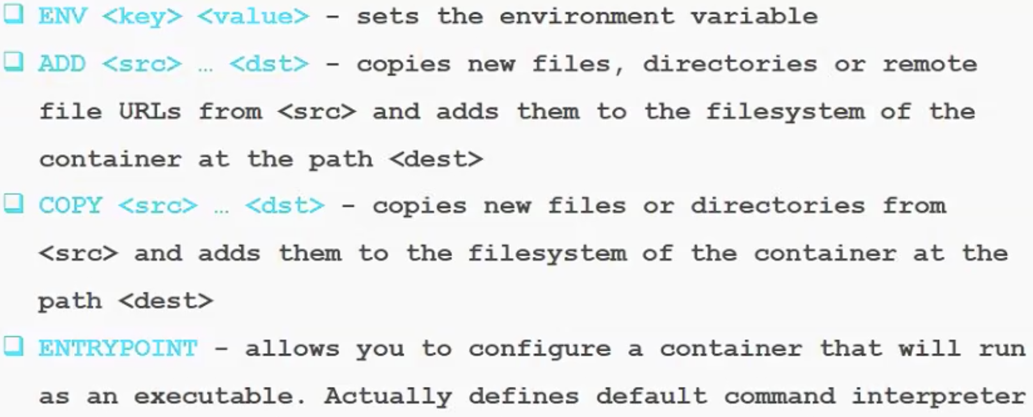
Dockerfile

Slide 14
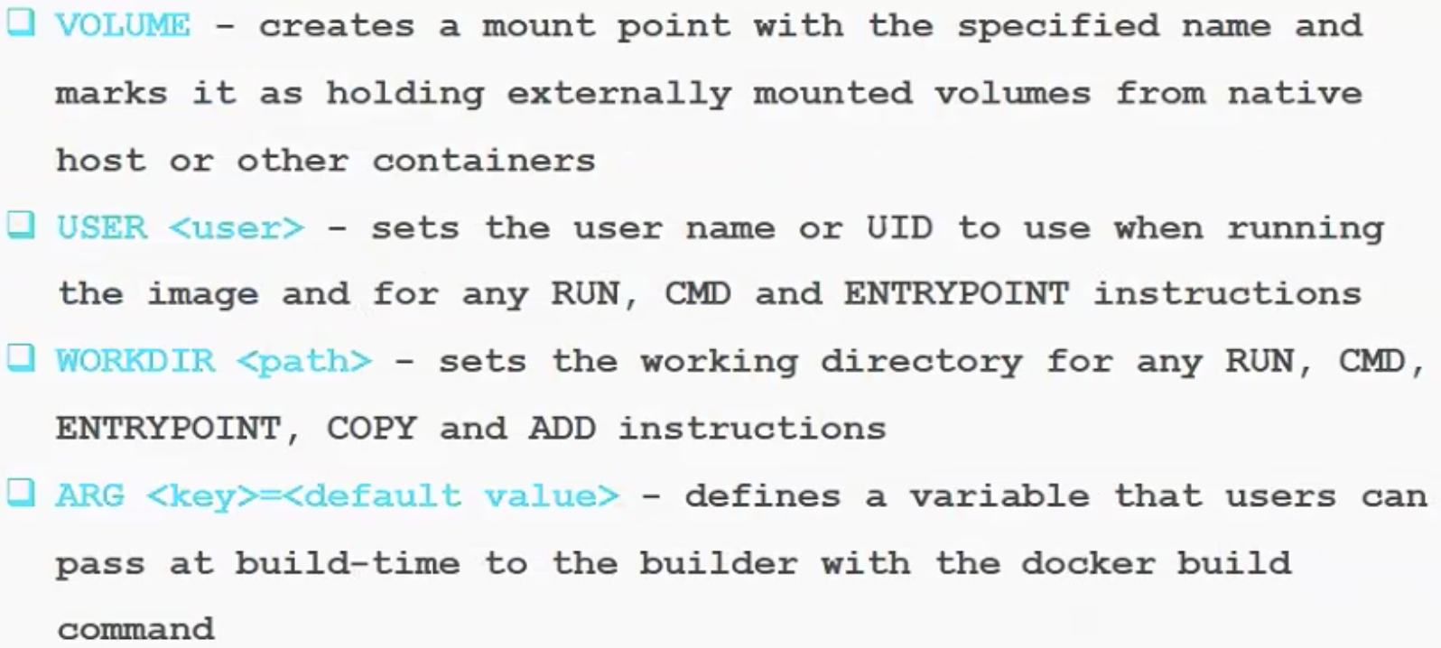
Dockerfile

Slide 15
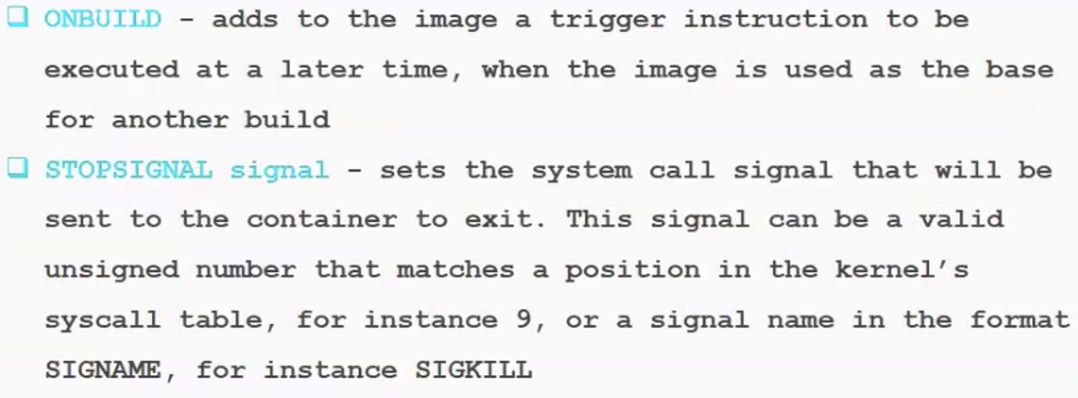
Dockerfile

Slide 16
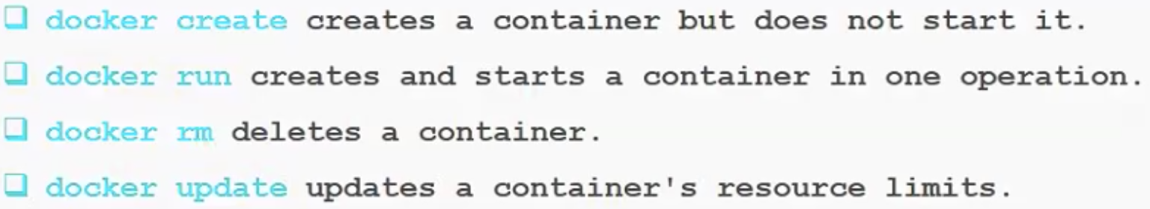
CLI – Container lifecycle

Slide 17
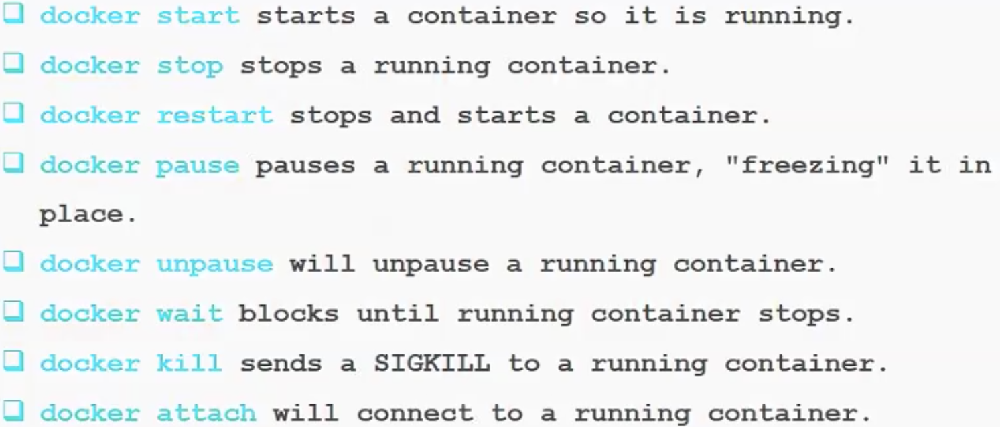
CLI – Container start/stop

Slide 18
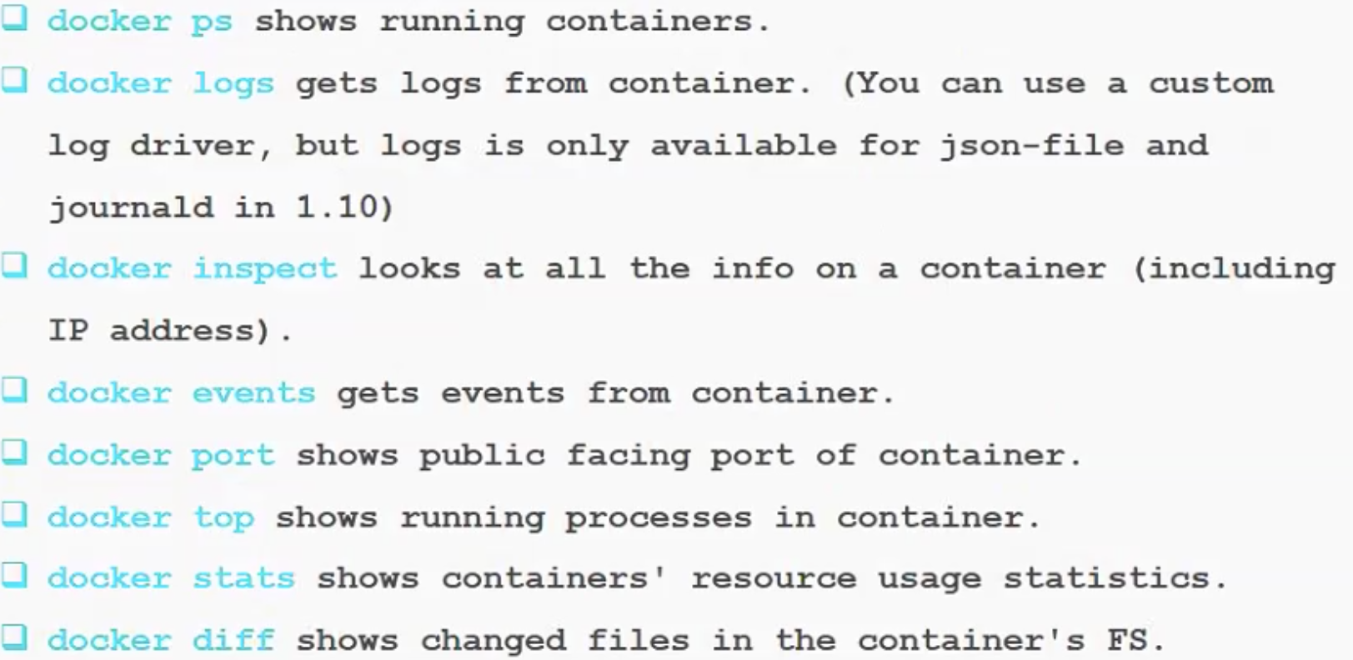
CLI – Container info

Slide 19
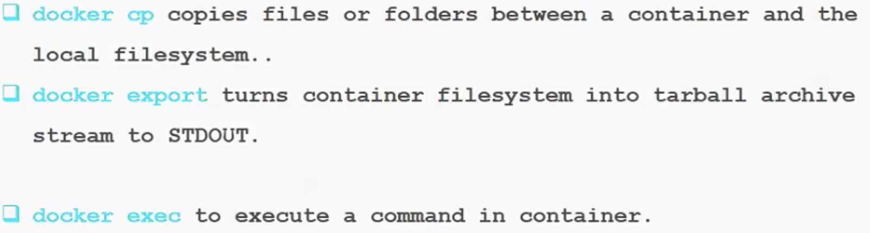
CLI – Container import/export/execute cmd

Slide 20
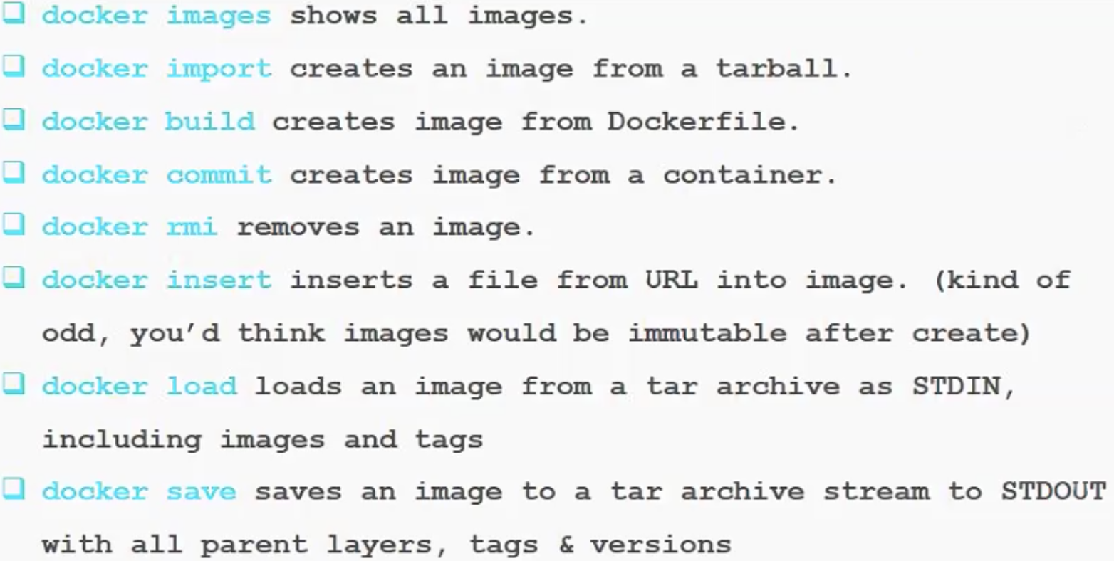
CLI - -Images lifecycle

Slide 21
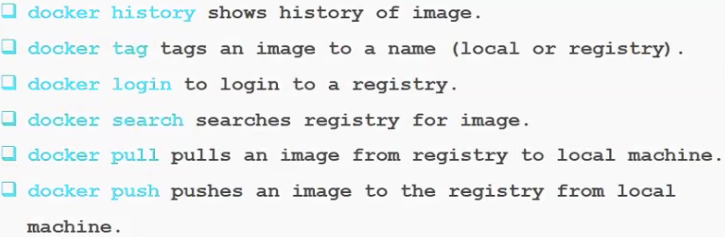
CLI – Info&Registry

Slide 22
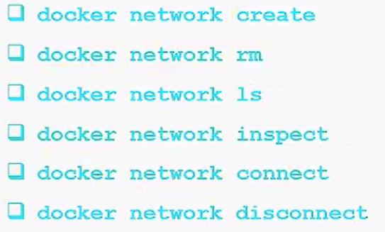
CLI-Network

Slide 23
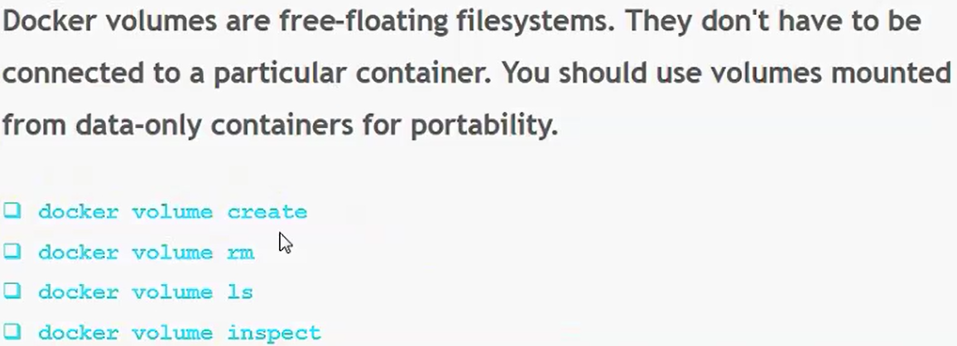
CLI Volumes

Slide 24
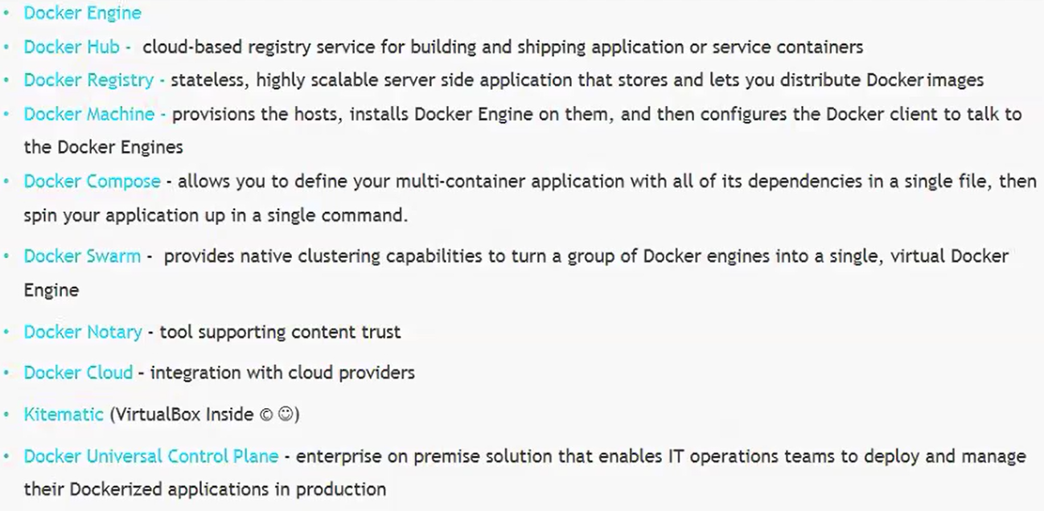
Docker toolbox

